Slide 1
Quarto (Part II): Reproducible research reports
John West
Rick Gilmore
Friday, August 15, 2025
Open Scholarship Bootcamp

Slide 2
Workshop Overview
My Quarto story
How I’ve used Quarto in my research
Examples of reproducible research reports
Internal facing
External facing
Next steps to “level up” research reports
Other Quarto applications

Slide 3
My Quarto story
R background in grad school (no rmarkdown)
Old workflow: Run analyses in R scripts > save workspace > execute output > copy results into manuscript > re-load workspace each session

Slide 4
R Workspace workflow - Disadvantages
Re-loading workspace creates dependency issues Possibility of human error due to loading workspaces and copying Results manually Emphasis on output rather than inputs (code and data) Not very transparent or reproducible Difficult to handle changes in underlying data Difficult to share with collaborators

Slide 5
A better way: Quarto
With Quarto, you can generate reproducible research reports using a variety of languages (e.g., R, bash, JavaScript, mysql, octave, ruby, sas, stata, fortran, python)
New workflow: Run analyses in a Quarto qmd document with “fresh” data each session > Render document with dynamically generated Results > Disseminate document, or keep internally for records

Slide 6
R Workspace workflow - Disadvantages | Quarto document workflow – Advantages
Re-loading workspace creates dependency issues Possibility of human error due to loading workspaces and copying Results manually Emphasis on output rather than inputs (code and data) Not very transparent or reproducible Difficult to handle changes in underlying data Difficult to share with collaborators | Rendering “from the ground up” eliminates dependency issues Automating input handling and Results generation minimizes human error Emphasis on “real” inputs (code and data) rather than outputs Transparent and reproducible Easily handles changes in underlying data Easier to share with collaborators

Slide 7
How I’ve used Quarto in my research
Two general use cases
Inward facing reports (e.g., preprocessing of sensitive data, standalone documents to produce outputs for use in other documents)
Outward facing reports (e.g., data manipulation, analysis output, figures)
Outward facing reports can be disseminated via formal mechanisms (e.g., OSF) or sent to colleagues as standalone documents
Tip: When disseminating a project, zip the entire directory to ensure file path references work

Slide 8
Quarto Document Demo Outward facing example adapted from Quarto project available at: https://osf.io/tz7nb/files/osfstorage#

Slide 9
Next steps to “level up” research reports
Consider linking to published Quarto html documents in text

Slide 10
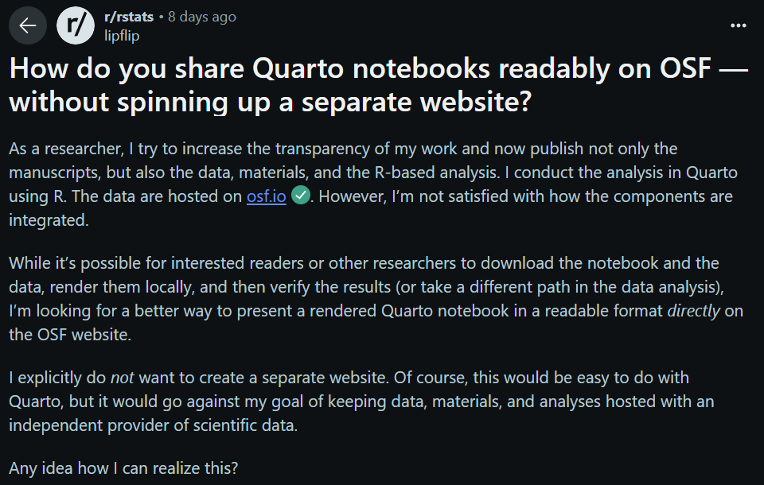
https://www.reddit.com/r/rstats/comments/1mid9zh/how_do_you_share_quarto_notebooks_readably_on_osf/

Slide 11
https://www.reddit.com/r/rstats/comments/1mid9zh/how_do_you_share_quarto_notebooks_readably_on_osf/

Slide 12
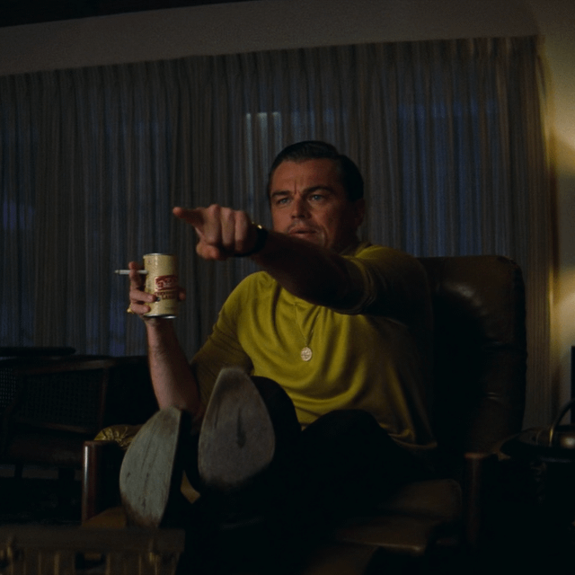

Slide 13
Next steps to “level up” research reports
Consider linking to published Quarto html documents in text
Pro: Allows you to direct the reader to a given analysis
Quarto has many website publishing options, including Quarto Pub, Netlify, and GitHub Pages https://quarto.org/docs/publishing/
Note: In my experience with the first two options, webpages tend to be slow if the page has many figures, so some optimization may be necessary
If multiple output styles are specified, all will be available on the published site to download e.g., https://quarto-ext.github.io/manuscript-template-jupyter/

Slide 14
Next steps to “level up” research reports
Use the renv R package to create a portable “copy” of R project environments, allowing others who want to render your Quarto project to do so with the same package versions as in the original project https://rstudio.github.io/renv/articles/renv.html
See Rick’s repo template from Part 1!

Slide 15
Next steps to “level up” research reports
Get fancy with author info with Quarto’s YAML schema, and include info such as author email, URL, ORCID, affiliations, etc. https://quarto.org/docs/journals/authors.html
Some attributed may not be supported for every html theme or output type
Try different html output themes! https://quarto.org/docs/output-formats/html-themes.html
Quarto has a lot of “out of the box” themes, but custom themes can also be created
Use reference managers like Zotero to insert citations https://quarto.org/docs/visual-editor/technical.html#inserting-citations

Slide 16
Other Quarto applications
In addition to creating reproducible research reports as shown here, Quarto can let you create…
Interactive dashboards https://quarto.org/docs/dashboards/
Blog posts
Professional and course websites
Presentations https://quarto.org/docs/presentations/
Scholarly manuscripts! https://quarto.org/docs/manuscripts/

